Slide 1
Basic Electrical and Electronics Engineering
LECTURE 1.1
Dr. Sonam Shrivastava/ Assistant Professor (Sr.) /SELECT

Slide 2
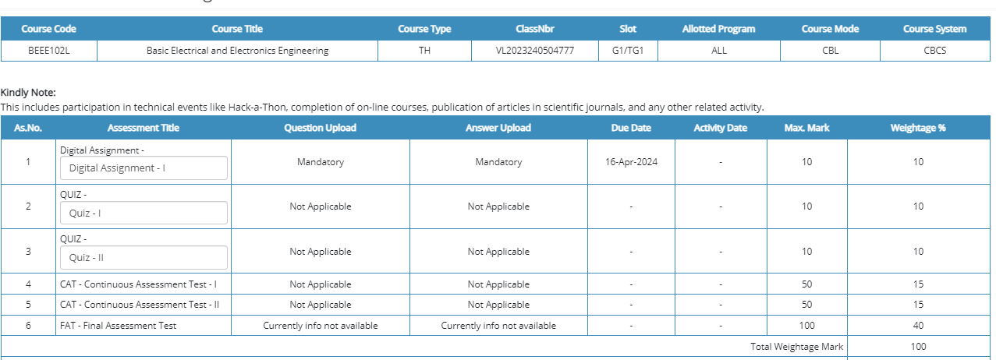

Slide 3
BEEE102L
Basic Electrical and Electronics Engineering
DC Circuits
AC Circuits
Magnetic Circuits
Electrical Machines
Semiconductor Devices and Applications
Digital Systems

Slide 4
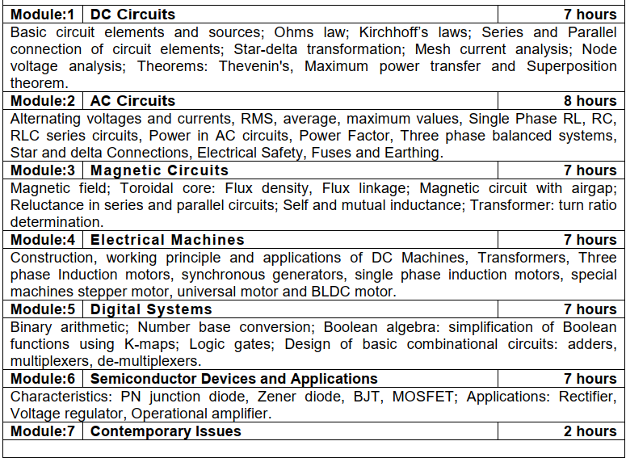

Slide 5
Books
Text Books
Allan R. Hambley, “Electrical Engineering -Principles & Applications”, 2019, 6th Edition, Pearson Education
V. D. Toro, Electrical Engineering Fundamentals, 2nd edition. PHI, 2014
Reference Books
R. L. Boylestad and L. Nashelsky, Electronic Devices and Circuit Theory, 11th edition. Pearson, 2012
DP Kothari & Nagrath, “Basic Electric Engineering”, 2019, Tata McGraw Hill

Slide 6
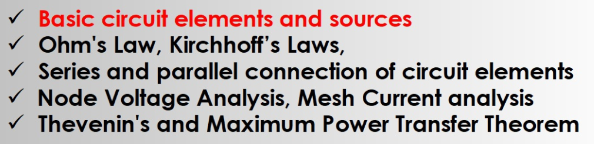
Module I. DC Circuits
Source transformation
Super position theorem

Slide 7
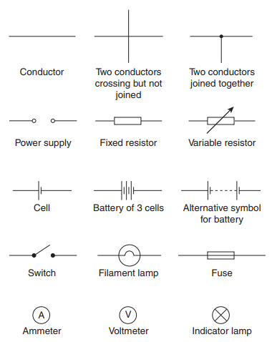
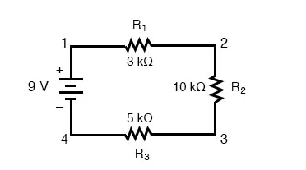
Electrical Circuits
A circuit consists of electrical elements connected together.
Example.

Slide 8
Electric Charge
Definition: Electric charge is a basic property of electrons, protons and other subatomic particles.
The quantity of electricity that flows in a given time or is held in a component such as a capacitor.
Symbol: q or Q
Unit: Coulomb (C)
Notes: Charges may be positive or negative
Like charges (e.g., + and +) repel each
other, unlike charges (+ and -) attract
each other

Slide 9
Electric Current
Definition: Rate of positive charge flow
Symbol: i or I
Units: Coulombs per second ≡ Amperes (A)
i = dq/dt
where q = charge (in Coulombs), t = time (in seconds)
Note: Current has polarity (flow direction).
If the drift of electrons in a conductor takes place at the rate of one coulomb per second the resulting current is said to be a current of one ampere.

Slide 10
Electric Potential (Voltage)
Definition: The work required to move a unit charge from a reference point to a specified point is voltage, measured in joules per coulomb or volts.
Symbol: v
Units: Joules/Coulomb ≡ Volts (V)
v = dw/dq
where w = energy (in Joules), q = charge (in Coulombs)
Note: Potential is always referenced to some point.
a
Subscript convention:
v_{ab} means the potential at a minus the potential at b.
v_{ab} = v_{a} - v_{b}
b

Slide 11
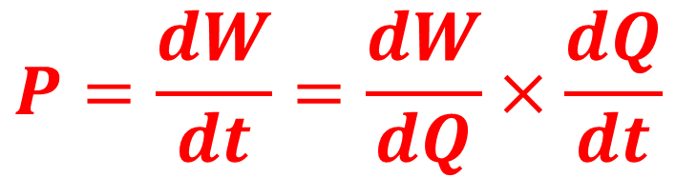

Electric Power
Definition: amount of energy transferred per unit time.
Symbol: p or P
Units: Joules per second ≡ Watts (W)
$$P= VI$$
$$P=\frac{dW}{dt}=\frac{dW}{dQ}×\frac{dQ}{dt}$$

